Slide 1



ACER: Accelerating Complex Event Recognition via Two-Phase Filtering under Range Bitmap-Based Indexes
Shizhe Liu¹,Haipeng Dai¹, Shaoxu Song²,
Meng Li¹, Jingsong Dai¹, Rong Gu¹, Guihai Chen¹
Nanjing University¹
Tsinghua University²
Notes:
Hello, everyone. I am Shizhe Liu from Nanjing University.
It is an honor to be here to present our work “ACER: …”.
This is a joint work done by people from Nanjing University and Tsinghua University.

Slide 2



Complex event recognition (CER): basic concepts
Complex Event Recognition aims to identify specific patterns
What is complex event recognition?
A pattern is composed of several primitive events
Primitive events are time-stamped "simple, derived events"
Commonly, the schema of the primitive events is
(event-type, attribute₁, … attribute_{N}, timestamp)
2/31
Notes:
So what is complex event recognition (CER for short)?
CER aims to identify specific patterns composed of several primitive events in event stores.
Primitive events, which are time-stamped "simple, derived events",
generally have diverse categories distinguished by their event types.

Slide 3
Complex event recognition (CER): query statement
When users want to query a complex event pattern, how to express it?
Users can use SQL standard to express it because ISO has issued new semantics in SQL [1] to support CER in 2016.
Your also can use SASE-like query style [2] (it is very easy to understand and is widely used in academia) to express a complex event pattern.
[1] https://www.iso.org/standard/78936.html
[2] ZStream: A Cost-based Query Processor for Adaptively Detecting Composite Events. In SIGMOD, 2009.
3/31
Notes:
Then, how to express or describe a complex event query?
Although the International Organization for Standardization introduced new SQL semantics in 2016 to support CER,
in this talk, we prefer to use a SASE-like query style to describe a query
because of its clarity and widespread use in academia.

Slide 4
Complex event recognition (CER): example
The schema of stock trade event is:
Given a query pattern [3] as follow:
(tradeType, stockName, volume, price, timestamp)
Domain: {BUY, SELL}
trade timestamp (ms)
PATTERN SEQ(SELL v₁, SELL v₂, SELL v₃)
USE skip-till-any-match
WHERE v₁.open > 100 AND v₁.stockName = ‘MSFT’
AND v₂.stocName = ‘INTC’
AND v₃.open < 2000 AND v₃.stocName = ‘AMZN’
WITHIN 6secs
event pattern
selection strategy
predicate conditions
window condition
[3] CORE: a Complex Event Recognition Engine. In VLDB, 2022.
4/31
Notes:
Let’s see an example. Consider that we have a stream named “Stock” that is emitting BUY and SELL events of particular stocks.
Currently, users are interested in all triples of SELL events where the first is a sale of Microsoft over 100 dollars, the second is a sale of Intel (of any price), and the third is a sale of Amazon below 2000 dollars. The query is shown in this figure.
Here, the PATTERN clause describes the detected event pattern, and the keyword SEQ is a temporal operator that indicates the sequential occurrence relationship;
USE clause specifies the selection strategy, in other words, the skip-till-any-match strategy, which allows the evaluation engines to skip any events, regardless of whether they can potentially match the previous results;
WHERE clause gives a predicate condition set;
WITHIN clause specifies the maximum distance between the first and last event in the pattern.

Slide 5
Simplified representation
PATTERN SEQ(SELL v₁, SELL v₂, SELL v₃)
USE skip-till-any-match
WHERE v₁.open > 100 AND v₁.stockName = ‘MSFT’
AND v₂.stocName = ‘INTC’
AND v₃.open < 2000 AND v₃.stocName = ‘AMZN’
WITHIN 6secs
event pattern
selection strategy
predicate conditions
window condition
Simplified representation
v₁.tradeType=‘SELL’
& v₁.open > 100
& v₁.stockName=‘MSFT’
Pattern SEQ( , , )
USING skip-till-any-match
WITHIN 6secs
v₂.tradeType = ‘SELL’
& v₂.stockName=‘INTC’
v₃.tradeType=‘SELL’
& v₃.open > 100
& v₃.stockName=‘AMZN’
5/31
Notes:
In this talk, we will use square, octagon, and trapezoid to simplify the representation of the above query.

Slide 6
Complex event recognition (CER): process steps
New ordered events
(arrival rate: 1 event/s)
.
.
.
Assume that the occurrence timestamp of the first events is 1.
PATTERN SEQ( , , )
USING skip-till-any-match
WITHIN 6secs
Query pattern
Step ❶:
Load & filter events
Step ❷:
Match & return results
Old
……
Evaluation Engine
S0
S1
S2
S3
New
Event Stores
Matched
tuples
Memory
……
Disk
6/31
Notes:
Commonly, the process of CER includes two steps:
first, loading events from disk based on a given query,
and second, sending these events to evaluation engines for matching (where ordered events are required as input).

Slide 7

Two methods for loading and filtering events
Fullscan-based: fullscan entire event stores
PATTERN SEQ( , , )
USING skip-till-any-match
WITHIN 6secs
Query pattern
Old
New
Event Stores
Costly I/O overhead
Memory
Disk
7/31
Notes:
Clearly, full-scanning entire event stores to identify primitive events has costly IO overhead
because many events cannot hold the query conditions at all.

Slide 8

Two methods for loading and filtering events
Fullscan-based: fullscan entire event stores
Index-based: use indexes to retrieve events
Indexes
PATTERN SEQ( , , )
USING skip-till-any-match
WITHIN 6secs
Query pattern
Old
Sounds feasible,
however,…
New
Event Stores
Memory
Disk
8/31
Notes:
A mainstream and practical approach is using index techniques to avoid retrieve irrelevant events.
However, However, we found that prior index-based methods still have a high latency in loading events.

Slide 9
Problems of prior index-based methods [4]
Significant index space overhead (they use B+ tree/LSM-Tree as indexes)
◎ higher predicate selectivity, higher index query latency
Query 1: 7 ≤ key ≤ 8
Query 1: 6 ≤ key ≤ 9
Access 2 pages
Root node
Access 4 pages
4
6
8
10
1
3
4
6
6
6
6
7
8
9
10
10
10
[4] Index-Accelerated Pattern Matching in Event Stores. In SIGMOD, 2021.
9/31
Notes:
The high latency in prior index-based methods for four reasons.
Firstly, B+ trees incur a significant index space overhead,
resulting in the queried predicate with high selectivity having a high query latency.

Slide 10
Problems of prior index-based methods [4]
Significant index space overhead (they use B+ tree/LSM-Tree as indexes)
◎ higher predicate selectivity, higher index query latency
Random access
◎ ︎ adjacent pages are logically continuous, but not necessarily physically continuous
Page 1
4
6
8
10
Page 4
Page 2
Page 5
Page 3
1
3
4
6
6
6
6
7
8
9
10
10
10
[4] Index-Accelerated Pattern Matching in Event Stores. In SIGMOD, 2021.
9/31
Notes:
Secondly, conducting range queries in tree-like indexes leads to random disk access, which slows down query efficiency.

Slide 11
Problems of prior index-based methods [4]
Significant index space overhead (they use B+ tree/LSM-Tree as indexes)
◎ higher predicate selectivity, higher index query latency
Random access
◎ ︎ adjacent pages are logically continuous, but not necessarily physically continuous
Additional sorting operations
◎ ︎ complexity of sorting is O(nlog₂n), complexity of fullscan is O(n)
When the amount of data is so large that it cannot be loaded into memory all at once, an external sort operation is required.
File 1
External sort
File 2
File 3
File 4
Disk
Memory
[4] Index-Accelerated Pattern Matching in Event Stores. In SIGMOD, 2021.
9/31
Notes:
Thirdly, additional sorting operations are essential to preserve event order, which brings costly sorting overhead.

Slide 12
Problems of prior index-based methods [4]
Significant index space overhead (they use B+ tree/LSM-Tree as indexes)
◎ higher predicate selectivity, higher index query latency
Random access
◎ ︎ adjacent pages are logically continuous, but not necessarily physically continuous
Additional sorting operations
◎ ︎ complexity of sorting is O(nlog₂n), complexity of fullscan is O(n)
Numerous irrelevant events
◎ ︎ only need 4 events, but return more than 10 events
Expected returned events
Actual returned events
[4] Index-Accelerated Pattern Matching in Event Stores. In SIGMOD, 2021.
9/31
Notes:
Lastly, despite using indexes to filter out irrelevant events,
the number of loaded events significantly exceeds those involved in matching
due to overlooking the window condition in the query.

Slide 13
Complex event recognition (CER): two categories
Fullscan-based: fullscan entire event stores
Index-based: use indexes to retrieve events
Indexes
PATTERN SEQ( , , )
USING skip-till-any-match
WITHIN 6secs
Query pattern
Old
Sounds feasible,
however,…
New
Event Stores
Memory
Disappointing
Disk
10/31
Notes:
Therefore, current index-based methods are struggling to accelerate CER.

Slide 14
Challenges in designing indexes to accelerate CER
→ Compression
❶ Significant index space overhead
Achieve low space overhead of indexes
→ Range Bitmap
❷ Random access
Ensure sequential access
❸ Additional sorting operations
Remove sorting operations
→ Two phase filtering
❹ Numerous irrelevant events
Avoid unnecessary access to events
11/31
Notes:
Overall, we encounter below four challenges in designing indexes to accelerate CER.
To address these challenges, we achieve low space overhead of indexes through compression
and employ Range Bitmap to avoid random access and additional sorting operations.
Most importantly, we propose a two-phase filtering algorithm based on the window condition to reduce unnecessary access to events.

Slide 15
Range bitmap - construction
Range Bitmap
Attribute value (V)
Events
Binary
Slice ③
Slice ②
Slice ①
32315563
0 1 1
0 1 0 0 1 1
0 0 1
1 0 1
1 0 1
1 1 0
0 1 1
11110001
00011100
01000010
Convert
Construct
Take away: each row in Range Bitmap stores the inverse code of the original value.
[5] Bitmap Index Design and Evaluation. In VLDB, 1998.
12/31
Notes:
Due to time limitations, we don't introduce the construction details of Range Bitmap.
We only need to know that each row in Range Bitmap stores the inverse code of the original value.

Slide 16
Range bitmap – range query
Range Bitmap
Attribute value (V)
Events
Slice ③
Slice ②
Slice ①
32315563
11110001
00011100
01000010
Query: V<= 4 → V<=100₍₂₎
Final bitmap
State’’
State’
State
11110001
‘1’
11110001
00000000
‘0’
00011100
01000010
‘0’
01000010
11111111
OR
operation
AND
operation
AND
operation
13/31
Notes:
Similarly, we only need to know that when using Range Bitmap to query a given range, the returned event sequence aligns with the original insertion sequence.

Slide 17
Range bitmap – range query
Attribute value (V)
Events
Final bitmap
Filtered events
32315563
11110001
Query: V<= 4
Take away: the sequence of filtered events that Range Bitmap returns are aligned with the origin construction/insertion sequence.
14/31
Notes:
Similarly, we only need to know that when using Range Bitmap to query a given range, the returned event sequence aligns with the original insertion sequence.

Slide 18
ACER structure overview
❷ Insert
❶ Store
Buffer Pool
Buffer 1
Buffer 2
Buffer 3
Buffer 4
❸ Generate
2-nd Index Block
Synopsis Table
Type
Cluster
Synopses
cluster₁
cluster₃
Page
Page
Page
RB₁ → index 1-st attribute
Index Block
❹Flush
Index Block
RB₂ → index 2-nd attribute
❺ Update
Timestamp list
RID list
Memory
cluster₂
cluster₄
Disk
15/31
Notes:
Then, based on Range Bitmap, we designed a novel index named ACER to accelerate CER.
ACER mainly has four components: Page, BufferPool, Synopsis Table, and Index Block.
When a new event arrives, …

Slide 19
ACER structure overview
❷ Insert
❶ Store
Buffer Pool
Buffer 1
Buffer 2
Buffer 3
Buffer 4
❸ Generate
2-nd Index Block
Synopsis Table
Type
Cluster
Synopses
cluster₁
cluster₃
Page
Page
Page
RB₁ → index 1-st attribute
Index Block
❹Flush
Index Block
RB₂ → index 2-nd attribute
❺ Update
Timestamp list
RID list
Memory
cluster₂
cluster₄
Disk
15/31
Notes:
When a new event arrives, it is first stored on the disk page, and its partial information is kept in the buffer pool.
When the buffer pool reaches its capacity, a new index block will be constructed and serialized to disk.

Slide 20
ACER – four components
Page
Buffer Pool
Index Block
Synopsis Table
Page
event₁
event₂
…
event_{n}
Page stores the entire event information persistently in row format.
16/31
Notes:
Note that the Page stores the entire event information persistently in row format.

Slide 21
ACER – four components
Page
Buffer Pool
Index Block
Synopsis Table
Page
Buffer Pool
event₁
event₂
Buffer 1
Buffer 2
Buffer 3
Buffer 4
…
event_{n}
Page stores the entire event information persistently in row format.
Buffer Pool temporarily holds events awaiting indexing.
Events within a single buffer have the same event type.
16/31
Notes:
Buffer Pool temporarily holds events awaiting indexing. And events within a single buffer have the same event type.

Slide 22
ACER – four components
Page
Buffer Pool
Index Block
Synopsis Table
cluster₁
cluster₃
2-nd Index Block
RB₁ → index 1-st attribute
RB₂ → index 2-nd attribute
Timestamp list
RID list
cluster₂
cluster₄
17/31
Notes:
Index Block contains several Range Bitmaps for indexing event attributes, a timestamp list, and an RID list.
The reason why we store timestamps is that we will use the window condition to filter Index Block and events.
Note that each Index Block has multiple clusters, and each cluster stores the events with the same type.
Then we can only store the event type once in each cluster.

Slide 23
ACER – four components
Page
Buffer Pool
Index Block
Synopsis Table
Synopsis Table
Cluster
Synopses
cluster₁
cluster₃
Type
2-nd Index Block
RB₁ → index 1-st attribute
RB₂ → index 2-nd attribute
1.Index Block ID: 4
2.Min & max values of first attribute: [2, 5]
3.Min & max values of second attribute: [1.8, 9.9]
4.Timestamp range
5.Storage region: [2,3]
Timestamp list
RID list
cluster₂
cluster₄
17/31
Notes:
The Synopsis Table logs synopsis information for each cluster across different Index Blocks.
This information can help us to skip querying irrelevant Index blocks.

Slide 24
Query: single variable query
Process: Query Synopsis Table → Query Index Block → Query Buffer Pool → Obtain events from stores
Pattern SEQ( , , )
USING skip-till-any-match
WITHIN 6secs
A single variable
Assume that the occurrence timestamp of the first events is 1.
query( )
Synopsis Table
Event arrival rate: 1 event/s
Cluster
Synopses
Type
❶
Old
Index Block 1
❷
Index Block 2
Index Block 3
❸
New
Buffer Pool
❹
Event Stores
Event Stores
18/31
Notes:
Then, let’s see an example about how ACER processes a single-variable query.
Suppose we want to query all squares from the event store, we first need to query the synopsis table to get the Index Block IDs that contain squares.
Secondly, we access index blocks based on Block IDs and obtain related RIDs.
We also need to obtain RIDs from the Buffer Pool due to the Buffer Pool also contains events.
Finally, we load the events from the disk according to the obtained RIDs.

Slide 25
Complex event query: overview
Complex event query
Split
Single variable query
…
Single variable query
…
Single variable query
Two-phase filtering algorithm
Target of two-phase filtering algorithm:
avoiding unnecessary disk access in indexes and events.
19/31
Notes:
When processing complex event patterns, ACER will split the query into multiple single-variable queries.
Besides, the two-phase filtering algorithm is used to avoid unnecessary disk access in indexes and events.

Slide 26
Complex event query - first phase filtering
Pattern SEQ( , , )
USING skip-till-any-match
WITHIN 6secs
Assume that the occurrence timestamp of the first events is 1.
query( )
Synopsis Table
Event arrival rate: 1 event/s
Cluster
Synopses
Type
Old
Index Block 1
Index Block 2
Index Block 3
New
Buffer Pool
Event Stores
Timestamp: 8
Timestamp: 23
2
8
17
23
20/31
Notes:
Let’s see the two-phase filtering algorithm how to work.
In the first-phase filtering, we choose the variable with minimum selectivity to query.
Then, based on query results and the window condition, we will generate time intervals that may contain matched results.
The time intervals are 2 to 8 and 17 to 23.

Slide 27
Complex event query - first phase filtering
Pattern SEQ( , , )
USING skip-till-any-match
WITHIN 6secs
Assume that the occurrence timestamp of the first events is 1.
Event arrival rate: 1 event/s
Old
Index Block 1
Timestamp range: [1,8]
Index Block 2
×
Timestamp range: [9,16]
Index Block 3
Timestamp range: [17,24]
×
Buffer Pool
Timestamp range: [17,24]
New
Event Stores
Timestamp: 8
Timestamp: 23
2
8
17
23
21/31
Notes:
Then, we check which Index Block’s timestamp range cannot overleap the time intervals,
if it cannot overleap, then this Index block can be marked without accessing.
Here the second index block and buffer pool are marked without accessing.

Slide 28
Complex event query – second phase filtering
Pattern SEQ( , , )
USING skip-till-any-match
WITHIN 6secs
Assume that the occurrence timestamp of the first events is 1.
query( )
Synopsis Table
Event arrival rate: 1 event/s
Cluster
Synopses
Type
Old
Index Block 1
Index Block 3
New
Event Stores
query( )
22/31
Notes:
In the second phase filtering, we first obtain other variable’s query results.

Slide 29
Complex event query – second phase filtering
Pattern SEQ( , , )
USING skip-till-any-match
WITHIN 6secs
Assume that the occurrence timestamp of the first events is 1.
Event arrival rate: 1 event/s
Old
8
23
5
6
22
2
7
New
2
8
17
23
Event Stores
×
23/31
Notes:
After that, we check whether a time interval whether include all variable’s query events’ timestamp.
If no, this time interval cannot generate any matched results.
That means time intervals 17 to 23 can be removed.

Slide 30
Complex event query – second phase filtering
Pattern SEQ( , , )
USING skip-till-any-match
WITHIN 6secs
Assume that the occurrence timestamp of the first events is 1.
Event arrival rate: 1 event/s
×
×
Old
8
23
5
6
22
2
7
New
2
8
17
23
Event Stores
×
23/31
Notes:
And the events whose timestamp within this time interval also should be skip access.

Slide 31
Complex event query – second phase filtering
Pattern SEQ( , , )
USING skip-till-any-match
WITHIN 6secs
Assume that the occurrence timestamp of the first events is 1.
Event arrival rate: 1 event/s
Ordered events
Ordered events
Ordered events
Old
8
5
6
2
7
Merge without sorting
New
Event Stores
Evaluation Engine
S0
S1
S2
S3
24/31
Notes:
Finally, we merge the events and send these events to evaluation engines for matching.
Note that events are ordered in each cluster and stores, then each variable’s results we obtain are ordered, that means we do not need sorting operation.

Slide 32
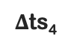
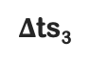
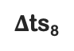
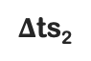
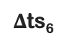
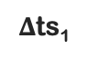
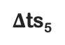
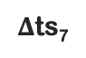
Optimizations
Compression
◎ delta compression
◎ ︎roaring encoding
Query optimizations
◎ avoid repeated access in Index Block
Index Block ①
Timestamp list
ts₁
ts₂
ts₃
ts₄
ts₅
ts₆
ts₇
ts₈
Index Block ②
+
+
v₁
v₃
Index Block ③
Compressed Timestamp list
ts₀
$Δ$ts₈
$Δ$ts₁
$Δ$ts₂
$Δ$ts₃
$Δ$ts₄
$Δ$ts₅
$Δ$ts₆
$Δ$ts₇
Index Block ④
Cache miss
↓
Repeated IO access
25/31
Notes:
Except above techniques, we also propose two optimization techniques to reduce the query latency further.
Due to time limitation, here we will not introduce them in details.

Slide 33
Experiments
Datasets
◎ three real-world datasets: Cluster, NASDAQ, and Crimes
◎ ︎three synthetic datasets: 10M events, 100M events, and 1G events
Loading & filtering baselines
◎ NaïveIndex
◎ ︎IntervlaScan (State-of-the-art)
◎ Fullscan
Metrics
◎ query latency
◎ index speedup → latency_{fullscan} / latency_{index}
◎ space overhead
◎ ︎average insertion latency
26/31
Notes:
We evaluate the performance of ACER against three baselines.

Slide 34
Speedup in two evaluation engines
(a) Cluster dataset
(b) NASDAQ dataset
(c) Crimes dataset
ACER reduces the query latency by up to one order of magnitude compared with Fullscan.
27/31
Notes:
Evaluation results show that ACER significantly outperform competitive state-of-the-art algorithms.
That is because ACER can filter more irrelevant events, and it has low index query overhead.

Slide 35
Query latency in real systems
ACER filters out more than 99% of events for three queries, and it reduces the query latency of Flink by 10×.
PATTERN SEQ(MSFT v1, GOOG v2, MSFT v3, GOOG v4)
FROM NASDAQ
USE skip-till-next-match
WHERE 326 <= v1.open <= 334
AND 120 <= v2.open <= 130
AND v3.open >= v1.open * 1.003
AND v4.open <= v2.open * 0.997
WITHIN 12 minutes
RETURN COUNT(*)
Query Q1
Note:
1. CDB is a commercial database
2. Pinot is a column store (we have build range bitmaps for related attributes)
3. Query 1, 2 and 3 are similar (the difference lies in predicate selectivity and window length)
28/31
Notes:
In three given queries, ACER filters out more than 99% of events, and it can reduce original query latency of Flink by 10×.

Slide 36
Storage overhead and insertion latency
Storage overhead
Insertion latency
For index-based methods, ACER always has a low index space overhead and low insertion latency.
29/31
Notes:
Besides, ACER always has a low index space overhead and low insertion latency compared with prior index-based methods.

Slide 37
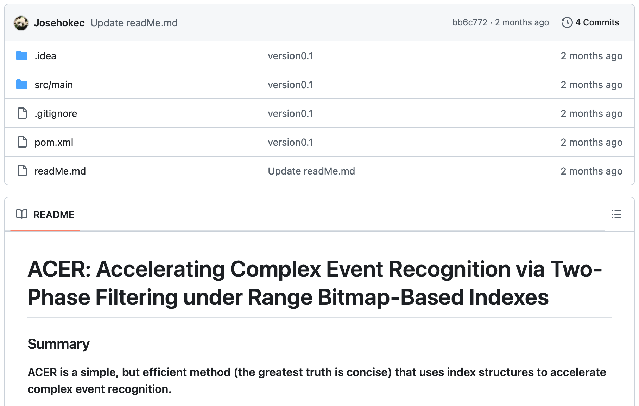
Conclusion
ACER is mainly based on Range Bitmap indexes, which can ensure disk access is sequential and output is ordered.
ACER uses two-phase filtering algorithm to avoid unnecessary disk access.
Evaluation results show that ACER significantly outperform competitive state-of-the-art algorithms.
Code: https://github.com/Josehokec/ACER4CER
30/31
Notes:
All in all, ACER is mainly based on Range Bitmap indexes, which can ensure disk access is sequential and output is ordered.
ACER uses a two-phase filtering algorithm to avoid unnecessary disk access.
We also shared our code here.

Slide 38
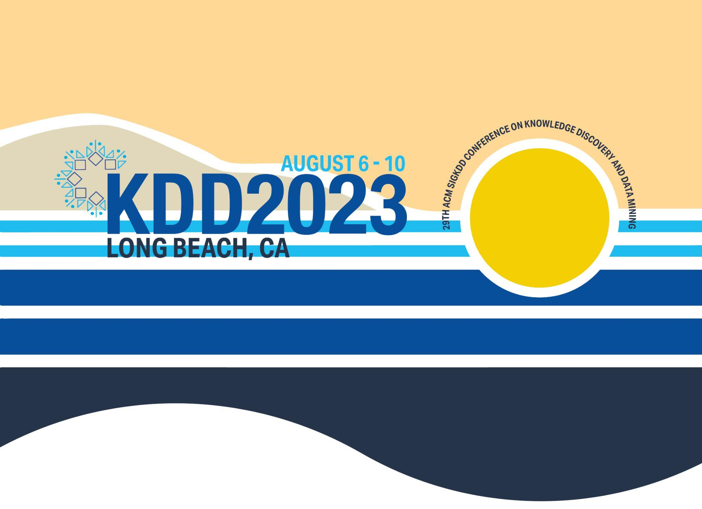
THANK YOU
Shizhe Liu, Nanjing University
shizheliu@smail.nju.edu.cn
https://github.com/Josehokec/ACER4CER
30/31
Notes:
That’s all, thank you for listening.

Slide 40
Naïve index-based methods for loading & filtering
Step 1: use B+ indexes to query all conditions and return related events
Step 2: sort and merge events to ensure the events are chronologically ordered
B+ Indexes
query( )
Pattern SEQ( , , )
USING skip-till-any-match
WITHIN 6secs
Query pattern
query( )
query( )
Old
Disordered events
Sort + Merge
New
Event Stores
Ordered events
Memory
Disk
9/31

Slide 41
State-of-the-art index-based methods [4] for filtering
Greedily choose partial conditions to query
Generate time intervals based on window condition
Obtain these events whose timestamps in the time intervals
They still have random access and need the sort operation!
B+ Indexes
query( )
Pattern SEQ( , , )
USING skip-till-any-match
WITHIN 6secs
Query pattern
query( )
Old
Index on timestamp
New
2
8
Event Stores
Time intervals
Memory
Sort-merge-join
Disk
[4] Index-Accelerated Pattern Matching in Event Stores. In SIGMOD, 2021.
11/31

Slide 42


Accelerating Complex Event Recognition via Two-phase Filtering under Range Bitmap-based Indexes
Presented by Shizhe Liu
(Aka Jose)
31/31

Slide 43
Scalable ML II
2024-08-29

Slide 44
RESEARCH
TRACK
ACER: Accelerating Complex Event Recognition via Two-Phase Filtering under Range Bitmap-Based Indexes
Shizhe Liu¹,Haipeng Dai¹, Shaoxu Song²,
Meng Li¹, Jingsong Dai¹, Rong Gu¹, Guihai Chen¹
Nanjing University¹
Tsinghua University²
Notes:
Hello, everyone. I am Shizhe Liu from Nanjing University.
It is an honor to be here to present our work“ACER: Accelerating Complex Event Recognition via Two-Phase Filtering under Range Bitmap-Based Indexes”.
This is a joint work done by people from Nanjing University and Tsinghua University.

Slide 45
Note that:
complex event recognition = complex event processing
/
historical analysis
real-time monitoring and processing

Slide 46
Bitmap structures
Bitmap₁
Bitmap₂
01234567
01010100
01234567
00010111
Set₁= {1,3,5}
Set₂= {3,5,6,7}

Slide 47
Bitmap structures
Bitmap₁
Bitmap₁
Bitmap₂
Bitmap₁
Bitmap₂
Set₁= {1,3,5}
Set₂= {3,5,6,7}
01234567
01010100
01234567
01010100
00010111
01234567
01234567
01010100
00010111
01234567
AND
operation
OR
operation
Bitmap₂
01234567
00010111
00010100
01010111
Set₁ ∩ Set₂
= Read_Bit(Bitmap₁ & Bitmap₂)
= {3,5}
Set₁ ∪ Set₂
= Read_Bit(Bitmap₁ | Bitmap₂)
= {1,3,5,6,7}

Slide 48
Bitmap structures
Attribute value (V)
Events
Bitmap(V=1)
Bitmap(V=2)
Bitmap(V=3)
Bitmap(V=5)
Bitmap(V=6)
32315563
00010000
01000000
10100001
00001100
00000010
Query: V = 2
Query: 0 < V < 8
Number of distinct value is large
Notes:
Number of bitmaps = Number of distinct values

Slide 49
Range bitmap - construction
Range Bitmap
Attribute value (V)
Events
Binary
Slice ③
Slice ②
Slice ①
32315563
0 1 1
0 1 0 0 1 1
0 0 1
1 0 1
1 0 1
1 1 0
0 1 1
11110001
00011100
01000010
Convert
Construct
Notes:
Range bitmap: query example

Slide 50
Range bitmap – range query
Query: V<=4
Range Bitmap
Attribute value (V)
Events
Slice ③
Slice ②
Slice ①
32315563
11110001
00011100
01000010
Notes:
Range bitmap: query example

Slide 51
High-level idea of ACER
Reduce index space overhead via compression
Keep sequential access & without sorting via Range Bitmap
Avoid unnecessary I/O access via two-phase filtering
Block 1
Block 2
Block 3
Size: 100MB
Block 4
Sort + Merge
First-phase Filtering
Compress
Block 1
Block 3
Second-phase Filtering
Size: 40MB

